Slide 1


Emergency Wallet: Never Miss a Transaction
Digital payment failures cost businesses billions. The Emergency Wallet is a backup solution for failed online payments. It temporarily covers transactions during outages, ensuring a seamless customer experience.
by Sai Kumar

Slide 2





The Problem: Payment Failures
High Failure Rate
Online payments fail 5-15% of the time.
Technical Causes
Server outages, maintenance, and other technical issues.
Significant Impact
Lost sales, customer frustration, and brand damage.
Real-World Example
20% of transactions failed during a major UPI outage.

Slide 3
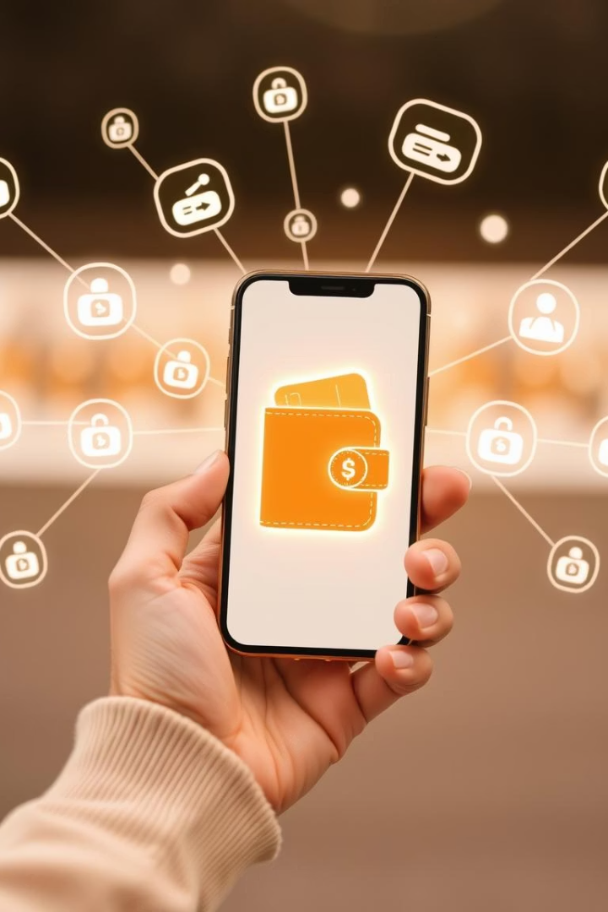
Solution: Emergency Wallet
Instant Activation
Activated automatically during payment failures.
Backup Funds
Funds a backup transaction, reimbursed later.
Seamless Integration
Integrated API for smooth switchover.
Real-time Monitoring
Continuously checks payment gateway status.

Slide 4






How It Works
Primary Payment Attempt
Customer tries UPI or card.
Failure Detection
System detects the failed transaction.
Emergency Wallet Prompt
Prompts customer to use the Emergency Wallet.
Temporary Coverage
Wallet covers the transaction amount.
Post-Failure Retry
Primary payment retried automatically.
Balance Reimbursement
Emergency Wallet balance is automatically reimbursed.

Slide 5

Key Benefits
30-40%
Reduced Cart Abandonment
Fewer lost sales opportunities.
15%
Increased Conversion Rates
Higher successful transaction rates.
High
Enhanced Customer Loyalty
Positive payment experience builds trust.
Maximized
Revenue Protection
Minimizes losses from payment failures.

Slide 6
Emergency Wallet vs. Traditional Methods
Traditional Methods
Emergency Wallet
Retry Logic: Causes delays, no guarantee.
Instant: No delays, immediate solution.
Alternative Options: Requires setup, lower conversion.
Seamless: No user setup needed.
Automatic: Works in the background.

Slide 7





Adoption and Implementation
Simple API Integration
Customizable Design
Tiered Pricing
Flexible plans based on transaction volume.
Easy to connect with existing payment gateways.
Branding and user interface can be customized.
Proven Success
Pilot program showed 99.9% success during failures.

Slide 8

Conclusion: Future-Proof Your Payments
The Emergency Wallet is essential for reliable online transactions. It minimizes revenue loss and maximizes customer satisfaction. This proactive solution handles inevitable payment failures. Contact us to learn how to implement it.

